Slide 1

Laird Sentrius BT510

Slide 2
Introduction
The Sentrius BT510 Sensor is a battery powered, Bluetooth 5 Long-Range integrated sensor platform enabling robust, reliable sensor data transfer.
It contains a temperature sensor, also seamlessly integrating open/close contact and motion/impact detection and BLE beaconing capabilities.
The BT510 is powered by Laird Connectivity’s field proven BL654 BLE module that integrates Nordic Semiconductor’s nRF52840 SoC silicon.

Slide 3
Activation the Sensor
The Sentrius BT510 doesn’t have a power switch. It is shipped with an installed battery and is in a low power state called shelf mode.
To wake the device, firmly press the button in the centre of the round face for at least three seconds until the green LED turns on. This puts the device in active mode.
Once in active mode, the BT510 is able to report back the sensor readings for the magnet, accelerometer, and temperature.
When you release the button, the green LED blinks once a second.

Slide 4
Sensor Configuration
The sensor has multiple properties (attributes) that can be used to configure it for a particular use case.
The read only parameters reflect the current state of the sensor. Issuing a JSON-RPC command to get the temperature does not cause the sensor to take a temperature measurement.
It returns the value of the last temperature measurement taken.

Slide 5
Event Log
All sensor events are recorded in a non-volatile log. The log can store seven days of measurements with a temperature sample rate of 15 minutes. Each event has a timestamp and a sample ID.
These values are the same as those found in the advertisements.
The log can be read in FIFO mode or LIFO mode. In FIFO mode, the oldest event is retrieved first. In LIFO mode, the last event is retrieved first.

Slide 6
Mobile Application
The Sentrius™ BT510 mobile application allows a user to configure a device, troubleshoot a device, see real-time sensor data, and update firmware.
To use the Sentrius™ BT510 mobile application, follow these steps:
From the applicable app store (Apple or Android) search for and install the Sentrius™ BT510 Sensor mobile application on your device.
To connect to the Sentrius BT510 sensor, press and hold the button in the center of the Laird Connectivity logo for three seconds.
Tap the search icon to discover the sensor(s) within range of the mobile device.
Select the applicable device. The sensor name defaults to BT510 when searching for the sensor. The BLE ID is printed on the label located on the back of the sensor. The BLE ID matches the number of the applicable sensor located in the search results Discover screen.
When prompted Pair with BT510, select Pair. If you select Cancel, the application disconnects from the sensor. The default pairing key is 123456. Once paired, the Main screen of the mobile application displays. This screen contains a graph of the temperature over time. It also indicates at what interval the temperature value is updated by the sensor.

Slide 7
Device Configuration
To access the configuration option, select Settings located near the bottom of the main screen.

Slide 8
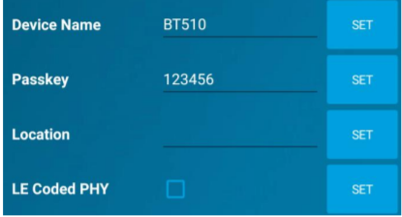
Sensor Configuration
Device Name – Used to assign a user-friendly name to the sensor
Passkey – A unique number assigned to the device to help protect the configuration values from being changed without permission. This passkey is used when pairing a sensor to a new mobile device
Location - Can be a given a name to help identify the area where the sensor is being stored.
LE Coded PHY – When selected the device will switch to transmitting a Coded PHY extended advertisement. The mobile app may not be able to reconnect to the BT510.

Slide 9
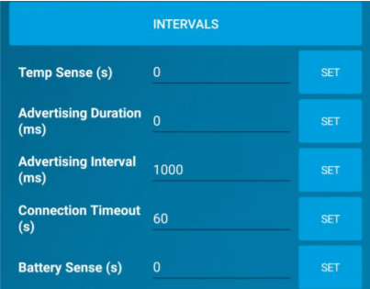
Interval Configuration
Temp Sense – The time in seconds when the sensor takes a temperature measurement.
Advertising Duration – Specifies how long the sensor should advertise each event. When set to 0, it advertises indefinitely. When set greater than 0, the duration cannot be less than four times the Advertising Interval.
Advertising Interval – The time between advertising packets.
Connection Timeout – The time in seconds that the mobile device is connected to the sensor. When set to 0, there is no timeout.
Battery Sense – The time in seconds when the sensor takes battery measurement.

Slide 10
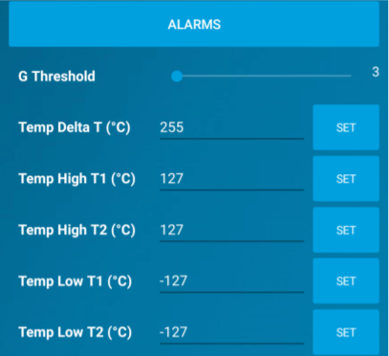
Alarm Configuration
G Threshold – Sets the acceleration threshold on the sensor. The lower the number, the lower amount acceleration acted on the device is required to trigger the alarm.
Temp Delta – The alarm is triggered when the temperature change between intervals is greater than value written here.
Temp High T1 – Alarm that triggers when the sensor temperature is higher than this value. It is also logged when triggered and has the high temp icon light up on the data screen.
Temp High T2 – Behaves the same as Temp High T1. This is just another alarm that can be triggered if the temperature is high than this value.
Temp Low T1 – Alarm that triggers when the sensor temperature is lower than this value. It is also logged when triggered and has low temp icon light up on the data screen.
Temp Low T2: This behaves the same as Temp Low T1. This is just another alarm that can be triggered if the temperature is lower than this value.

Slide 11
Update Firmware
Select the Update icon located near the bottom of the screen.
If the current firmware on the sensor is out of date, it is shown to have update package available.
Select the UPDATE button to begin the update process. It updates the bootloader first if it is out of date and then updates the firmware. Once the update is complete, a window appears that indicates success or failure.

